Slide 1
Book Recommendation System

Slide 2
Team members and mentor
Tharun kumar p
Prasanthi r
Basanagouda sb
Pooja ravindra patil
Aruna meesala
NEHA GUPTA

Slide 3
Recommendation System
A recommendation engine is a class of machine learning which offers relevant suggestions to the customer. Before the recommendation system, the major tendency to buy was to take a suggestion from friends. But Now Google knows what news you will read.
A recommendation system is one of the top applications of data science. Every consumer Internet company requires a recommendation system like Netflix, Youtube, a news feeds, amazon etc.

Slide 4
Types Recommendation system
Content-Based Filtering
Collaborative-based Filtering
Hybrid Filtering Method
Hybrid Filtering Method

Slide 5
Book Recommendation
A book recommendation system is a type of recommendation system where we have to recommend similar books to the reader based on his interest.
The books recommendation system is used by online websites which provide ebooks like google play books, open library, good Read’s, etc.
Now here we will use the Collaborative based filtering method to build a book recommender system.

Slide 6
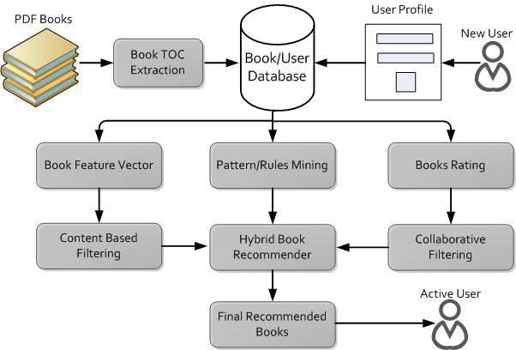
System architecture

Slide 7
Dataset Description
we have 3 files in our dataset which is extracted from some books selling websites.
Books – first are about books which contain all the information related to books like an author, title, publication year, etc.
Users – The second file contains registered user’s information like user id, location.
Ratings – Ratings contain information like which user has given how much rating to which book.

Slide 8
Load Dataset
Importing libraries and datasets.
Pre-processing data: we have some extra columns which are not required for our task like images and URLS . And we will rename the columns of each file as the name of the column contains space, and uppercase letters so we will correct as to make it easy to use.
EDA:Exploratory data analysis.

Slide 9
EDA
Extract users and ratings .
Extract users and ratings .
Extract books that have received more than 50 ratings.
Create Pivot Table

Slide 10
Modelling
Here we will use the nearest neighbors algorithm which is the same as K nearest which is used for clustering based on euclidian distance.
Euclidean Distance – This distance is the most widely used one as it is the default metric that SK-learn library of Python uses for K-Nearest Neighbour. It is a measure of the true straight line distance between two points in Euclidean space
But here in the pivot table, we have lots of zero values and on clustering, this computing power will increase to calculate the distance of zero values so we will convert the pivot table to the sparse matrix and then feed it to the model.

Slide 11
Now we will train the nearest neighbors algorithm. here we need to specify an algorithm which is brute means find the distance of every point to every other point.
Let’s make a prediction and see whether it is suggesting books or not. we will find the nearest neighbors to the input book id and after that, we will print the top 5 books which are closer to those books. It will provide us distance and book id at that distance.
Successfully we built a book recommendation system.

Slide 12
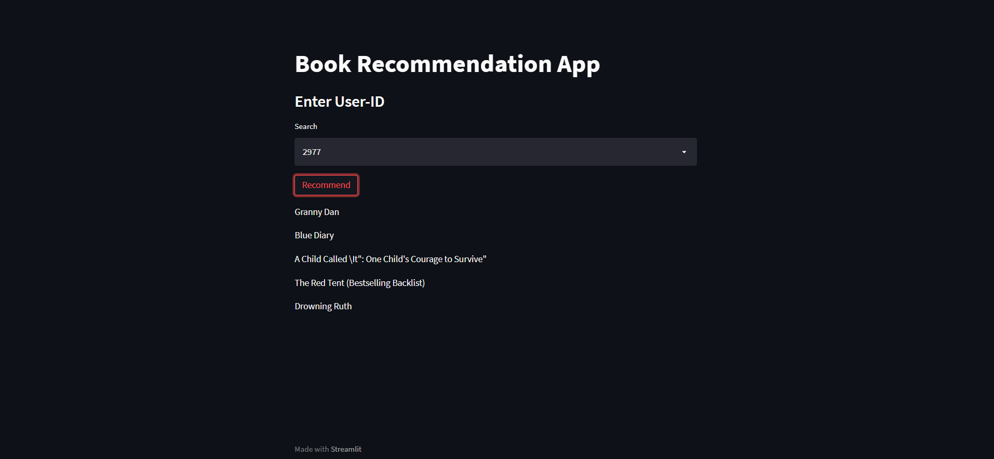
Deployement

Slide 13
Conclusion
All of our systems– purely content-based, purely collaborative-filtering, and hybrid– performed quite well.
Looking back on the project, one thing that we might have chosen to do differently in retrospect would have been to spend more time searching for a dataset of ratings with a higher rating variance per user.
Then we had been able to find such a dataset, our implementations of algorithms would have been tested on data that would have been more representative of what a typical commercial recommendation system could access in creating its predictions

Slide 14
tHANKYOU

